Slide 1

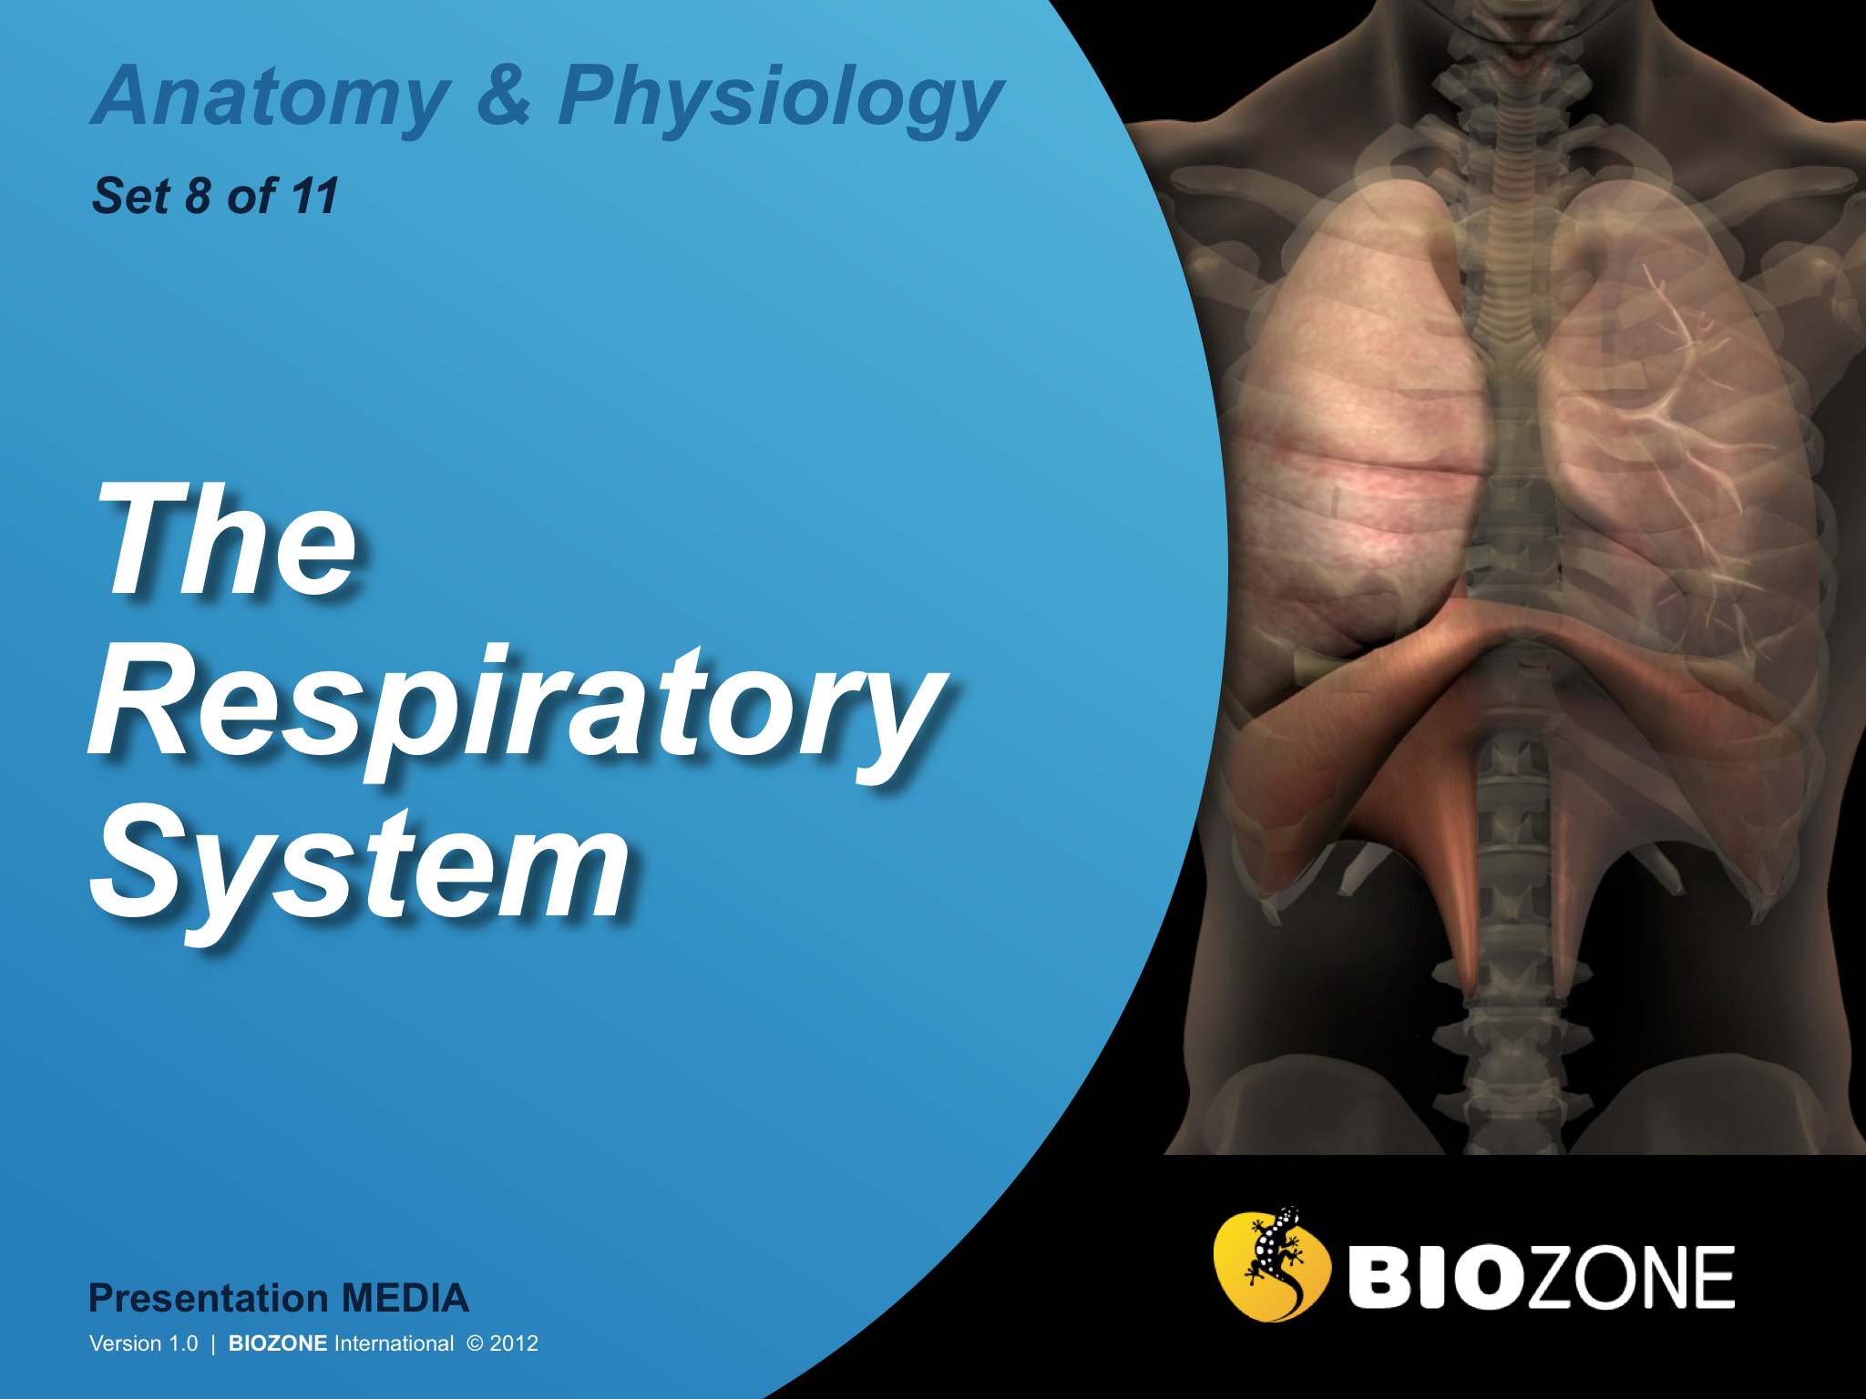

Slide 2
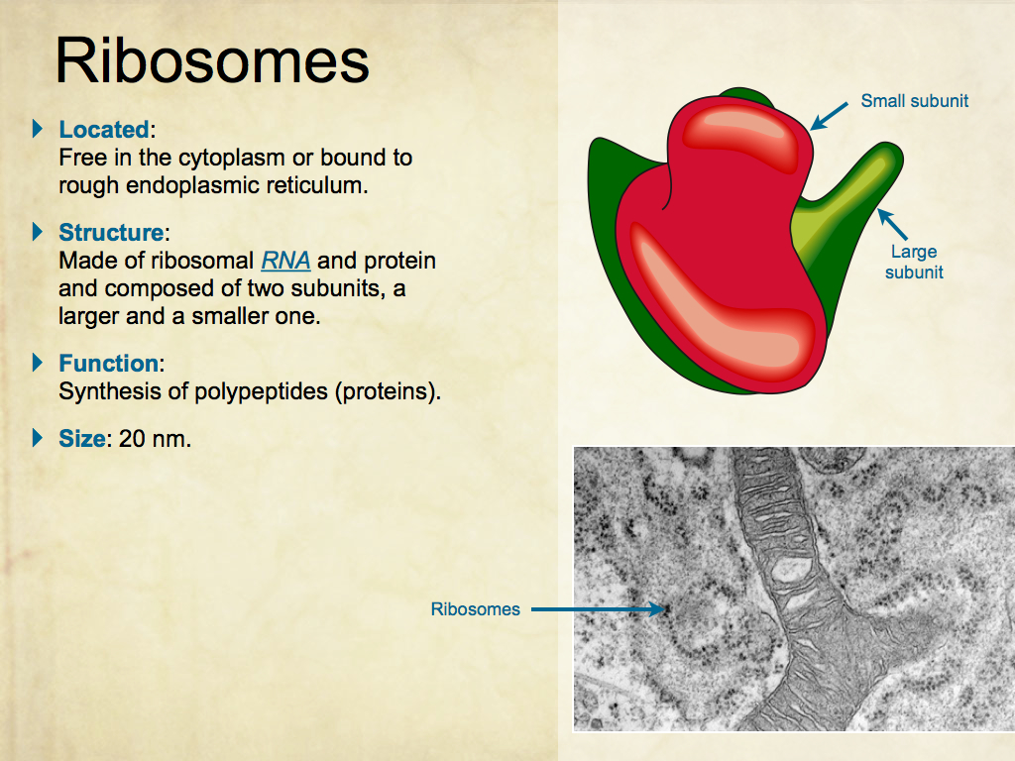
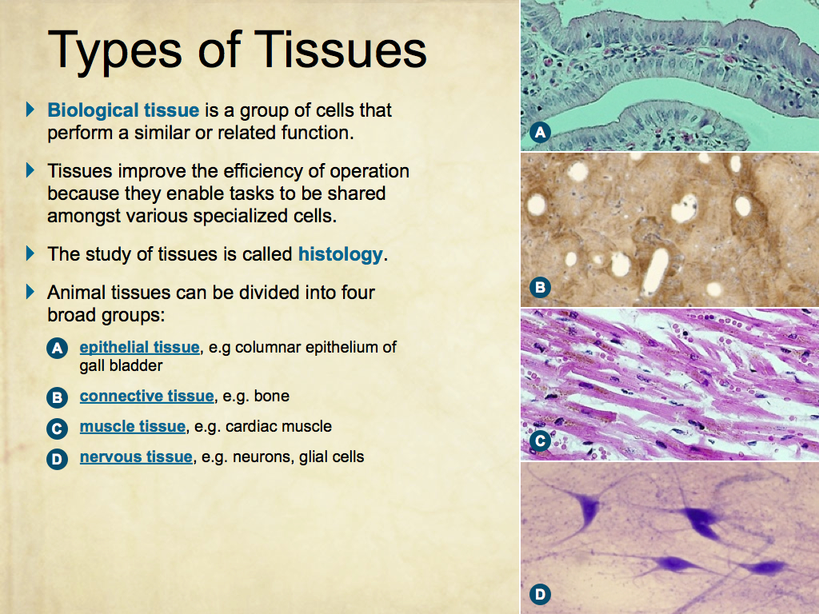
Using Presentation Media
BIOZONE Presentation Media
can be used either as a simple slide show or as an interactive lesson.
  Hyperlinks within the text take you to related slides.
Italicized hyperlinks link to the glossary of definitions.
Bold hyperlinks give direct access to specific slides.

Slide 3
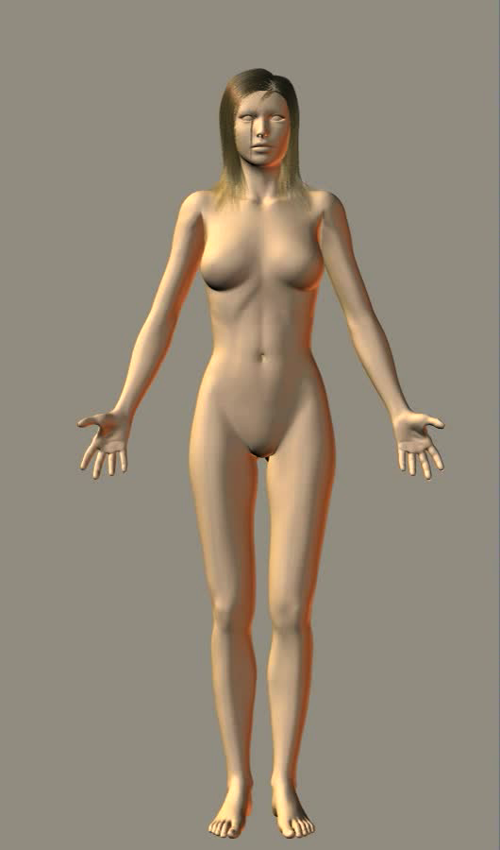
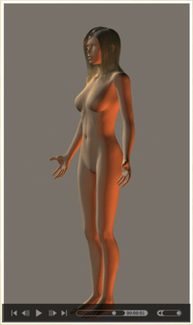
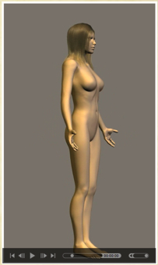
Using Presentation Media
BIOZONE Presentation Media can be used either as a simple slide show or as an interactive lesson
  The movie player allows you to rotate objects.
The movie loops continuously when activated
Use the movie controls in Keynote or Powerpoint
Pause the movie, then drag the slider to rotate the object back and forth

Slide 4
Introduction
  Interacting systems
  Contexts
Breathing
  Breathing in humans
  The respiratory system
  Respiratory gases
Measuring Lung Function
  Spirometry
  Lung volumes
  Lung capacity
Gas Transport
  Hemoglobin and myoglobin
  Transport of CO2
  Oxygen transport
Control of breathing
  Controlling breathing
Respiratory Diseases
  Smoking
Changes in Lung Function
  Exercise
Glossary

Slide 5
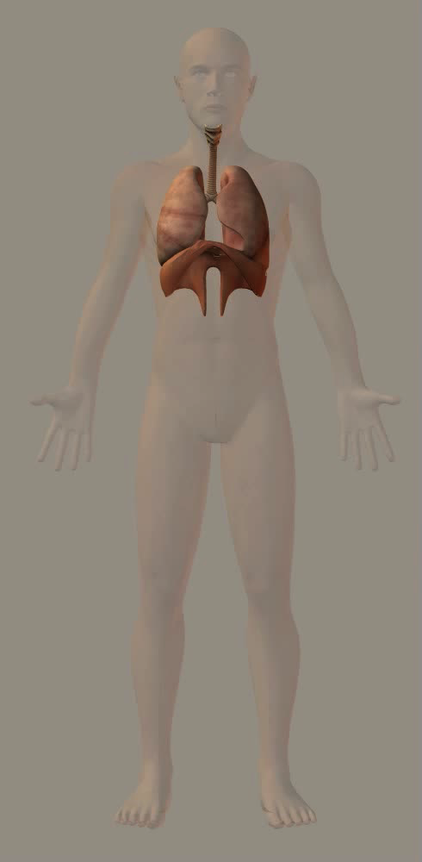
The Respiratory System
The organs of the gas exchange (or respiratory) system are vital as they enable the exchange of respiratory gases essential to life.
The system comprises the nasal cavity (and occasionally the oral cavity), larynx, trachea and bronchi, and lungs.
The diaphragm forms the floor of the thoracic cavity, separating the thoracic and abdominal cavities.
  The diaphragm is essential for inhalation and exhalation by changing the volume of the thoracic cavity.

Slide 6
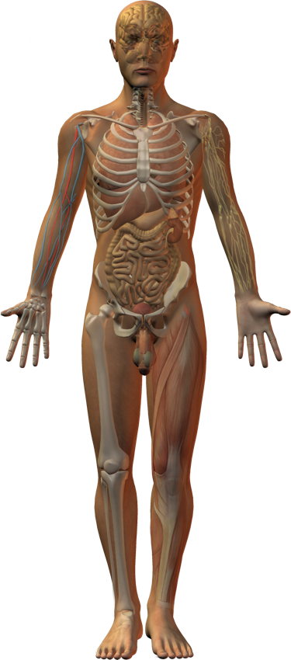
Interacting Systems
Nervous system
Endocrine system
Cardiovascular system
Lymphatic system and immunity
The respiratory system provides an interface for gas exchange with the external environment.
It is ultimately responsible for exchanges of respiratory gases (O2 and CO2) between the body’s cells and the environment.
These respiratory gases are transported in the blood.
The interactions of the respiratory system with other systems are described on the following slides.
Digestive system
Urinary system
Integumentary system
Reproductive system
Skeletal system
Muscular system

Slide 7
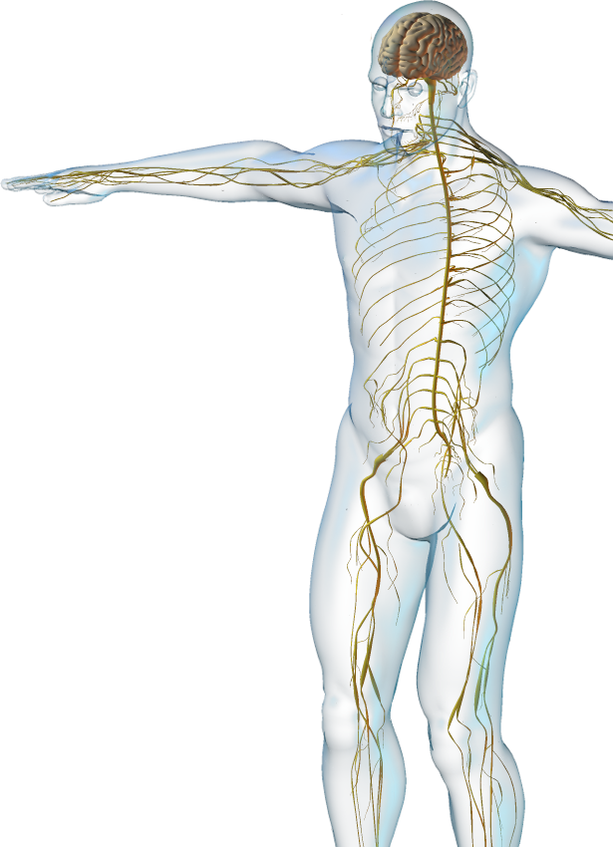
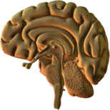

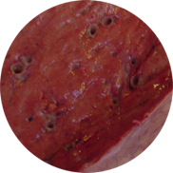
Nervous System
The respiratory system interacts with the nervous system:
  Respiratory control centers in the medulla and the pons regulate the rate and depth of breathing.
  Sensory feedback to the respiratory control center is provided by stretch receptors in the bronchioles and chemoreceptors in the aorta and carotid arteries.

Slide 8
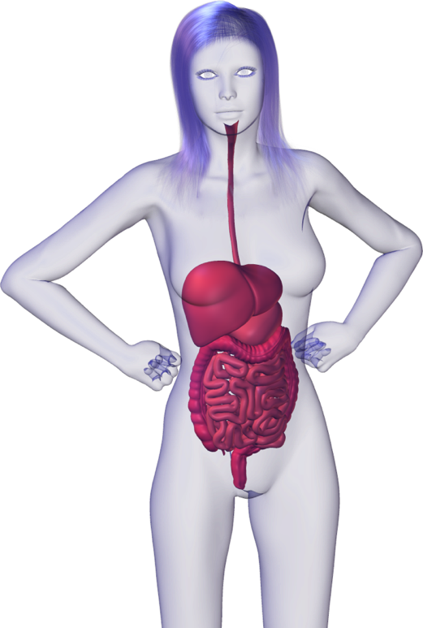



Digestive System
The respiratory system interacts with the digestive system
  The digestive system provides the nutrients required by the respiratory system.
  The respiratory system provides oxygen for the digestive organs and removes carbon dioxide.

Slide 9
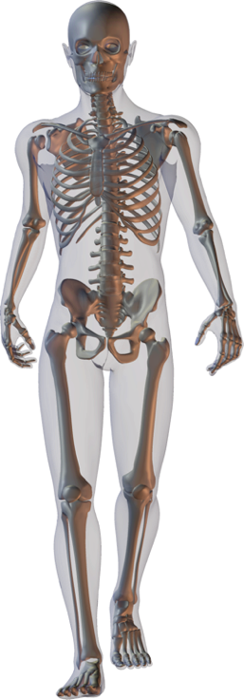

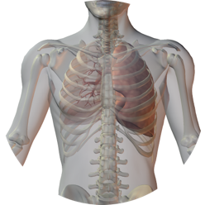
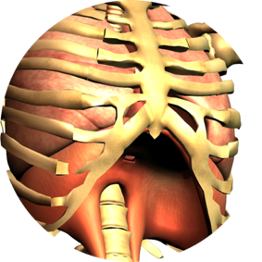
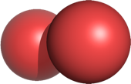
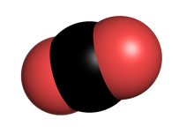
Skeletal System
The respiratory system interacts with the skeletal system:
  The ribcage and sternum enclose and protect the lungs and bronchi from damage.
  Expansion and elastic recoil of the ribcage produce the volume
  changes necessary to ventilate the gas exchange surface (breathing).
O2
CO2

Slide 10
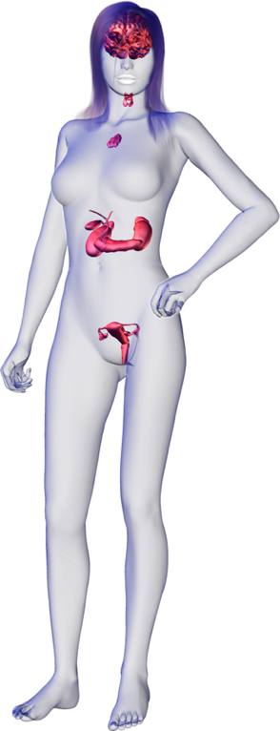
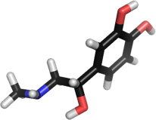
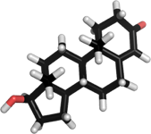
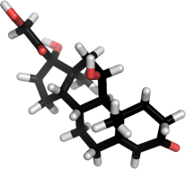
Endocrine System
The respiratory system interacts with the endocrine system
  Epinephrine from the adrenal (suprarenal) glands, atop the kidneys, acts as a bronchodilator, expanding the small airways of the lungs.
  Testosterone promotes enlargement of the larynx at puberty in males.
  Cortisol has a role in lung maturation and a number of other hormones, including thyroid hormones, directly or indirectly influence breathing rate.
Epinephrine
Testosterone
Cortisol

Slide 11
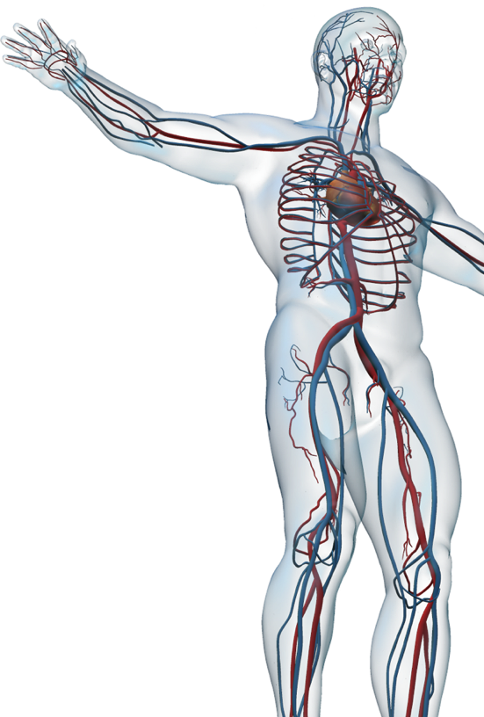

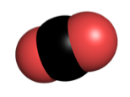
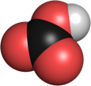
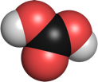
Cardiovascular System
The respiratory system interacts with the cardiovascular system:
  Blood transports respiratory gases.
  The carbonate-bicarbonate system in blood contributes to blood buffering.
  Blood proteins (e.g. immunoglobulins) also contribute to blood buffering.

Slide 12
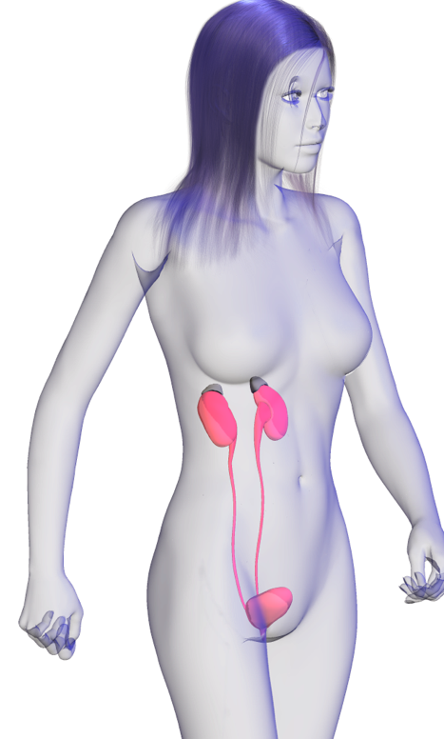
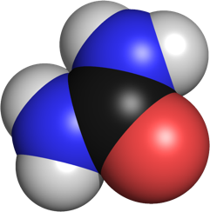
Urinary System
The respiratory system interacts with the urinary system:
  Kidneys dispose of the waste products of metabolism, such as urea and hydrogen ions (but not CO2, which is breathed out).
Urea

Slide 13
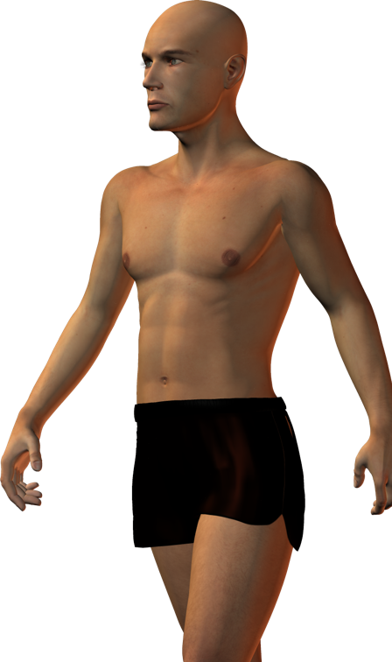
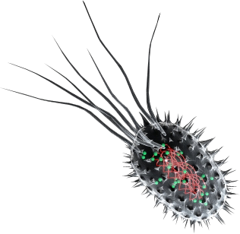
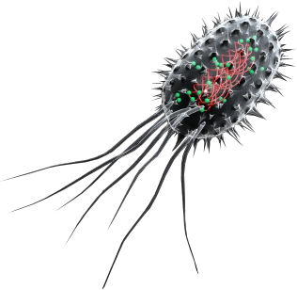
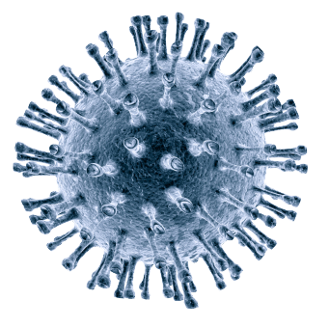
Integumentary System
The cardiovascular system interacts with the integumentary system:
  The skin forms a surface barrier to cushion and protect the lungs and associated structures.
  The respiratory system provides oxygen for the skin and removes carbon dioxide.

Slide 14
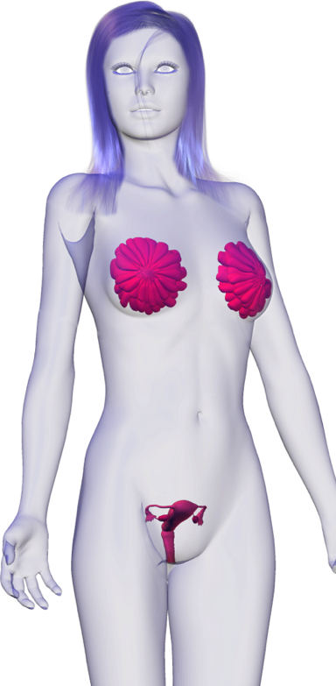
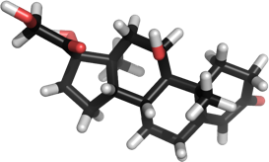
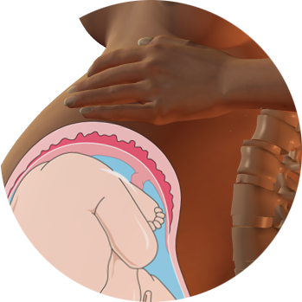
Reproductive System
The respiratory system interacts with the reproductive system:
  Pregnancy has significant effects on breathing, mediated largely through sex hormones.
  In pregnancy, the enlarged uterus pushes abdominal organs up and outwards and compromises the functioning of the diaphragm and lungs.
Estradiol

Slide 15
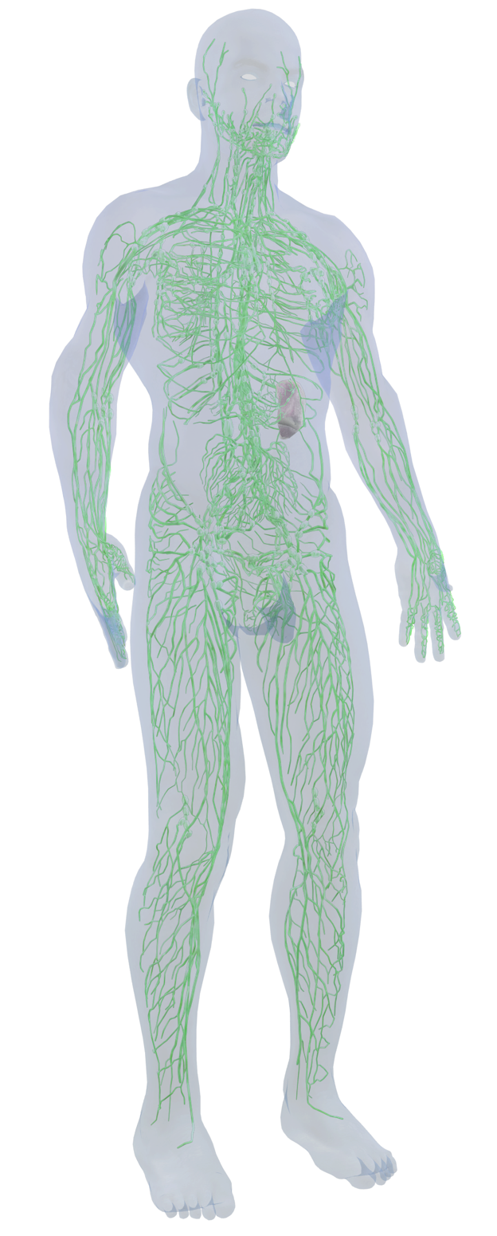
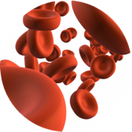
Lymphatic System
The respiratory system interacts with the lymphatic and immune systems:
  The immune system provides general protection against pathogens. Specifically, the tonsils protect against pharyngeal and upper respiratory tract infections.
  The lymphatic system helps to maintain blood volume required for efficient transport of respiratory gases.
Istock
Istock

Slide 16
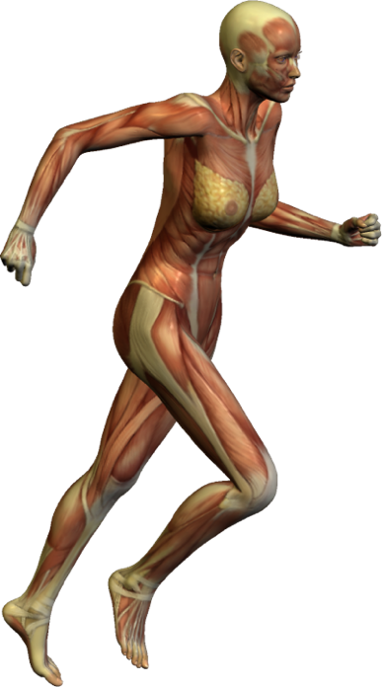
Muscular System
O2
The respiratory system interacts with the muscular system:
  Diaphragm and intercostal muscles (with the ribcage) produce the volume changes necessary for breathing.
  Regular aerobic exercise improves the efficiency of the respiratory system.
CO2

Slide 17
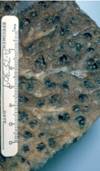
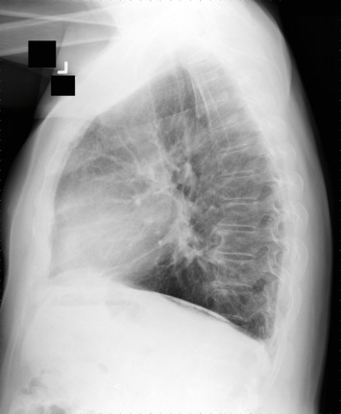
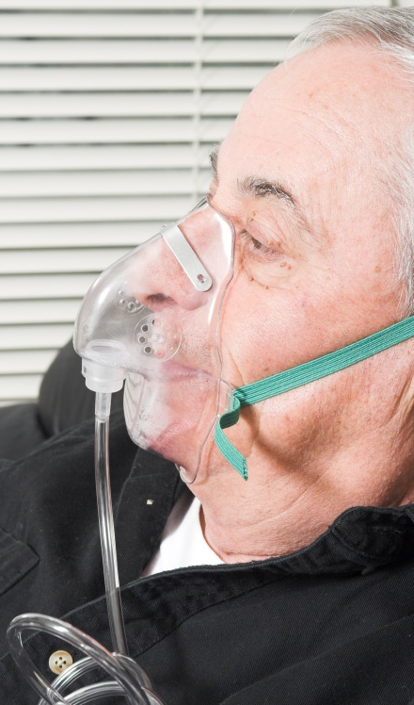
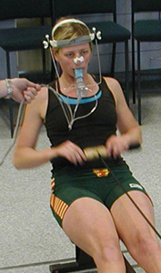
Contexts
Disease
What are the
diseases of the
respiratory system
and what are their
symptoms?
Medicine and Technology
How do we
prevent,
diagnose, and
treat respiratory
disease?
Taking a Breath
The Respiratory System
The respiratory system can be affected by disease and changes in response to training and aging.
Medical technologies can be used to diagnose and treat respiratory disorders. Exercise and lifestyle management can prevent some respiratory diseases.
Image: Clinical cases CC 2.5
CDC
The Effects of Aging
How does
aging affect
the respiratory
system?
Exercise
What are the
effects of
exercise on the
respiratory
system?
iStock

Slide 18
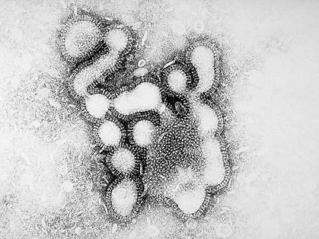
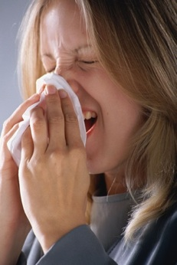
Disease
The respiratory tract is directly exposed potential pathogens with every inhalation of air.
Respiratory diseases can range from life-threatening lung infections to simple sinus infections. They can be infectious or non infectious.
The respiratory tract has developed numerous defenses against infection.
Influenza virus
DS
Eyewire

Slide 19
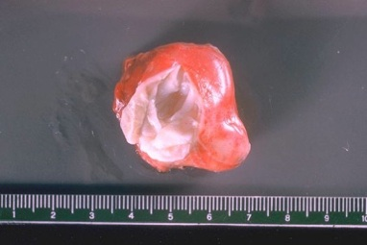
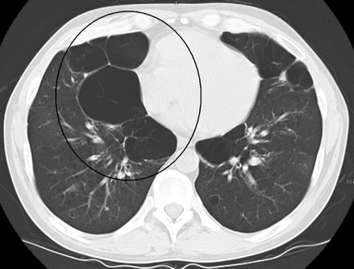
Medicine and Technology
Medical science has developed treatments for numerous lung disorders.
  Everyday disorders, such as asthma, can be treated with the appropriate drugs via inhalers.
  More serious diseases, such as cancers, may be treated with intravenous drugs, radiotherapy, or surgery.
Some lung conditions are not treatable, but medical imaging and tests can at least allow a diagnosis, which can help doctors to plan a program to alleviate the symptoms in a patient.
Cyst removed from lung
CDC
CT scan showing effect of emphysema
Photo James Heilman cc 3.0

Slide 20
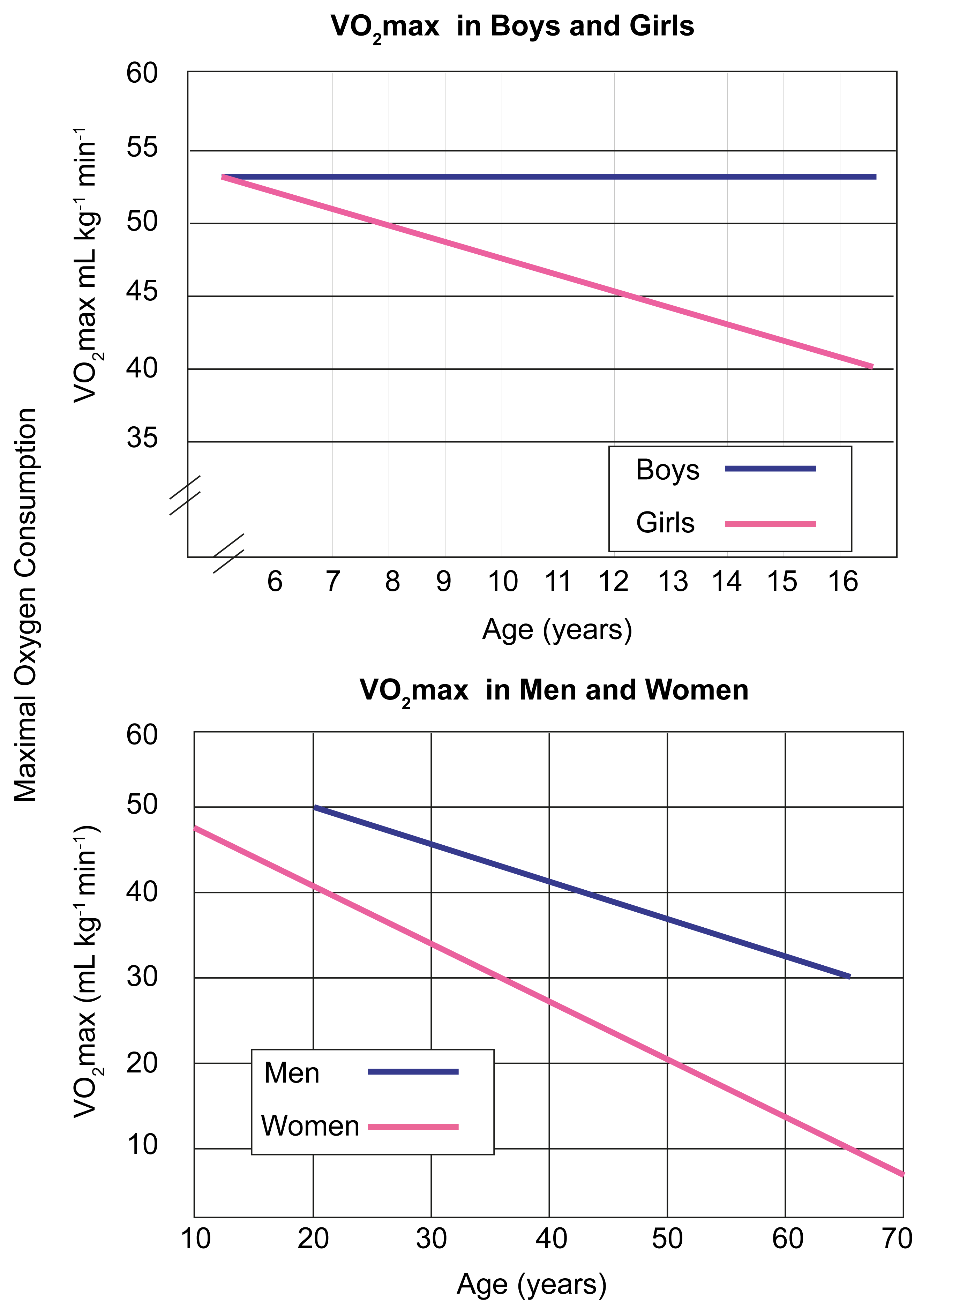
Age and Lung Function
Lung function changes with age.
  Children tend to breathe relatively larger volumes of air at rest than adults.
Some changes in lung function are related to changes in muscle mass (especially in males).
Reduction in the elasticity of lung tissue, especially in elderly, can make breathing more difficult.
VO2max is a measure of the maximum capacity to transport oxygen during exercise

Slide 21
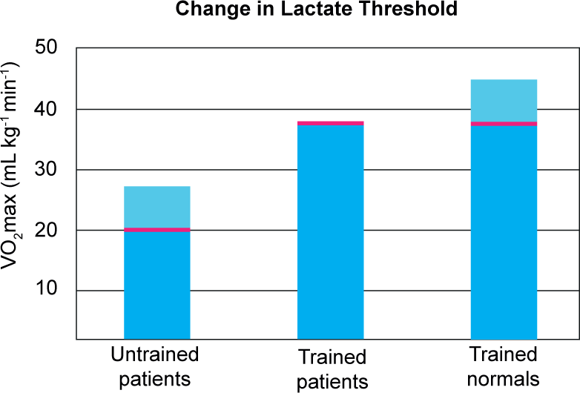
Exercise
Exercise has both short and long term effects on the function of the respiratory system.
Short term effects include increases in the rate and depth of breathing.
Long term effects include:
  Greater ventilation efficiency associated with improved muscular strength
  An increase in both the diameter and number of capillaries in the lungs.
VO2max
VO2max
Lactate threshold
VO2max
Long term changes in the respiratory system contribute to greater cardiovascular efficiency. With aerobic training, patients with heart disease increased their VO2max and lactate thresholds to levels similar to those of healthy, trained individuals.

Slide 22

Breathing
Breathing (ventilation) provides a constant supply of fresh air to the lungs and helps to maintain a large diffusion gradient for respiratory gases across the respiratory membrane.
  Oxygen must be breathed in to supply the respiratory needs of the body’s cells.
  Carbon dioxide from metabolism must be removed by breathing out.
The volume of gas breathed in and out varies with the physiological demands placed on the body.
Because the bronchioles of the lungs end in blind sacs (the alveoli) humans (like all mammals) use a tidal (in then out) mechanism for breathing.
CA

Slide 23
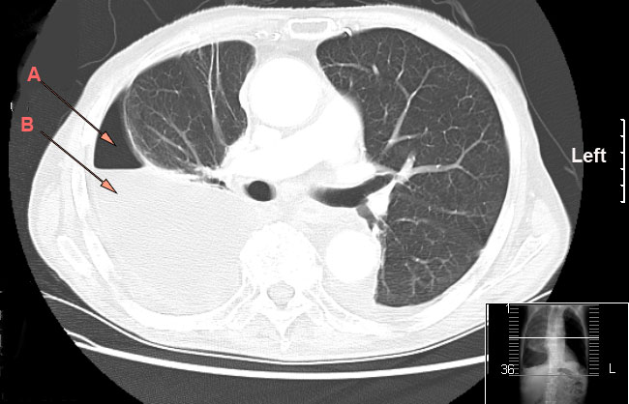
Intrapleural Pressure
Intrapleural pressure refers to the pressure inside the pleural cavity.
This is always negative (i.e. less than atmospheric pressure).
This creates a suction which keeps the lungs inflated.
If the pleural cavity is ruptured, the air pressure may become equal with that of the atmosphere, causing a collapsed pneumothorax.
  This causes serious interference with breathing.
Drriad CC 3.0
The pleural cavity is the small space between the pleural membranes. A indicates air where the lung has pulled away from the membrane. B indicates fluid on the lung.

Slide 24



Changing Pressure
Air flows into and out of the lungs because of changes in the air pressure inside the lungs.
Expansion of the lungs increases their volume and thus decreases the intrapulmonary pressure.
  Air from outside the lungs rushes in in response to the pressure gradient.
When lung volume reduces during expiration, intrapulmonary pressure increases and air moves out through the mouth or nose.
Boyle’s law states that at a constant temperature, the pressure and volume of a gas are inversely proportional i.e. as pressure increases the volume of a gas decreases. Increasing the volume increases the space between molecules and reduces pressure.
Decreasing the volume decreases the space between molecules and increases pressure.

Slide 25
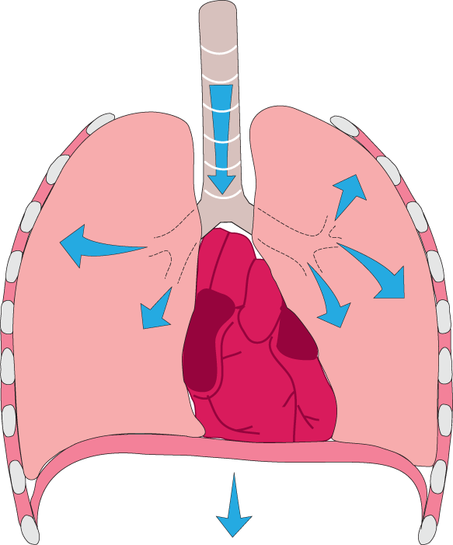
Inspiration
1a
External intercostal muscles contract causing the ribcage to expand and move up
During quiet breathing (at rest) inspiration is achieved by increasing the space (and therefore decreasing the pressure) inside the lungs.
Air then flows into the lungs in response to decreased pressure inside the lungs.
Inspiration is always an active process involving muscle contraction.
1b
Diaphragm contracts and moves down.
2a
Thoracic volume increases, lungs expand, and the pressure inside the lungs decreases
2b
Air flows into the lungs in response to the pressure gradient

Slide 26
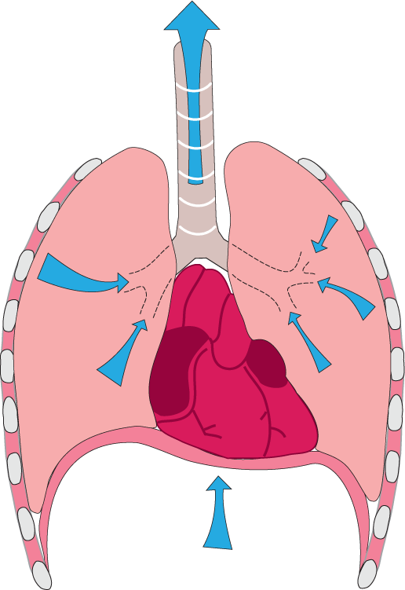
Expiration
1a
In quiet breathing, external intercostal muscles and the diaphragm relax. Elasticity of the lung tissue causes recoil.
During quiet breathing, expiration is achieved passively by decreasing the space (and thus increasing the pressure) inside the lungs.
Air then flows passively out of the lungs to equalize with the air pressure.
In active breathing, muscle contraction is involved in bringing about both inspiration and expiration.
1b
In forced breathing the internal intercostals and abdominal muscles also contract to increase the force of expiration.
2
Thoracic volume decreases and the pressure inside the lungs increases.
3
Air flows passively out of the lungs in response to the pressure gradient

Slide 27

The Respiratory System
The paired lungs of mammals, including humans, are located within the thorax.
  They are connected to the outside air by way of a system of tubular passageways:
    trachea
    bronchi
    bronchioles
The lungs of an average adult weigh about 1 kg and have a volume of between 4-6 L.
The diaphragm is a dome-shaped sheet of skeletal muscle.
Larynx
Trachea
Bronchus
Bronchioles
Right lung
Left lung
Diaphragm

Slide 28


Inside the Lungs
Bronchioles
The trachea divides into two bronchi, each of which leads to one lung.
Each bronchus divides many times, terminating in the respiratory bronchioles.
Each bronchiole gives rise to 2-11 alveolar ducts and numerous alveoli.
Ciliated, mucus-secreting epithelium lines the trachea and bronchi. It traps and removes dust and pathogens before they reach the gas exchange surfaces.
Photo: K Pryor
Cross section of lung showing bronchioles
Ciliated cells
EII
Ciliated cells lining a bronchus.

Slide 29

Alveoli
O2 in, CO2 out
The alveoli provide a large surface area for gas exchange (about 70 m²).
  Gases are exchanged by diffusion between the alveoli and the surrounding blood capillaries.
Each lung contains more than 150 million alveoli.
A phospholipid surfactant lines the inside of each alveolus.
The walls of the small bronchioles lack cartilage but have a large amount of smooth muscle.
The smallest respiratory bronchioles subdivide into the alveolar ducts (between 2-11). These give rise to numerous alveoli.
Istock
Blood capillaries
0.3mm
The alveoli tend to recoil inward (deflate) after each breath. Surfactant prevents complete collapse after deflation (increase pulmonary compliance).

Slide 30

Internal Structure of Alveoli
Monocyte
There is a close physical relationship between the alveolar membranes and the surrounding capillaries.
Phagocytic monocytes and macrophages are also present to protect the lung tissue.
Elastic connective tissue enables expansion and recoil of the alveoli.
Connective tissue cell
Connective tissue containing elastic fibers
Alveolar space
Surfactant
Respiratory membrane
Nucleus of epithelial cell
Alveolar macrophage
Alveolar space
Red blood cell in capillary

Slide 31

The Respiratory Membrane
The respiratory membrane is the term for the layered junction between:
  the alveolar epithelial cells
  the endothelial cells of the capillary
  the associated basement membranes (thin, collagenous layers that underlie the epithelial tissues)
Gases move freely across
the membrane.
Interstitial space
Nucleus of endothelial cell
Surfactant is a phospholipid produced by cells in the alveolar walls.
Alveolar epithelial wall
0.5 µm
O2
CO2
Epithelial basement membrane
Red blood cell
Capillary basement membrane
Capillary endothelium

Slide 32

Zones of the Lungs
 | Trachea
 | Primary bronchi
 | Bronchus
 | Bronchi
 | Bronchioles
 | Respiratory bronchioles
 | Alveolar ducts
 | Alveolar sacs
The lungs can be divided into conducting and respiratory zones. The respiratory zone takes up about 3 L of the volume. It is the largest portion of the lungs and is the zone of gas exchange.
The conducting zone can be termed the anatomical dead space as no gas exchange takes place here. It consists of the bronchioles, bronchi, trachea and nasal passages. Its purpose is to moisten and warm the air as it travels into the respiratory zone of the lungs.
Conducting zones
Transitional and respiratory zones

Slide 33


Respiratory Gases
The percentages of the gases in the air change between inhalation and exhalation.
Respiratory gas | Approximate percentages of O2 and CO2
 | Inhaled air | Air in lungs | Exhaled air
O2 | 21.0 | 13.8 | 16.4
CO2 | 0.04 | 5.5 | 3.6

Slide 34


Spirometry
A spirometer is used to measure the volume of air exchanged during breathing and the rate of breathing.
A simple spirometer consists of a weighted drum containing oxygen or air, inverted over a chamber of water.
More modern equipment can directly measure air flow and gas composition.
An incentive spirometer (used at home to improve tidal volume. The user can immediately see the volume they produce).
Photo: Johntex CC 2.5
Modern equipment for spirometry
Photo: Joe Mabel CC 3.0

Slide 35



Spirometry
During inspiration
  Air is removed from the chamber, causing the drum to sink and the upward deflection is recorded on the paper of the rotating drum
During expiration
  Air is added to the the chamber, causing the drum to rise. A downward deflection is recorded on the drum.
Pulley
Sealed air drum
Spirometer trace
Paper
Rotating drum
Water
Pen holder and counter balance

Slide 36


Measuring Lung Function
Total adult lung capacity varies between 4 and 6 L and is greater in males.
The vital capacity, (the volume exhaled after a maximum inhalation), is somewhat less than this because of the residual volume of air that remains in the lungs even after expiration.
Once measured, the tidal volume can be used to calculate the pulmonary ventilation rate (PV), which describes the amount of air exchanged with the environment per minute.
Photo: Wintec academy of sport
CA

Slide 37

Spirogram
A spirogram is a recorded trace of changes in lung volume.
The spirogram below shows the various volumes of the lungs during quiet breathing and exercise.
Increasing tidal volume during exercise
Vital capacity
Inspiratory reserve
Inspiratory capacity
Total lung capacity
Tidal Volume
Expiratory reserve volume
Residual volume

Slide 38


Lung Volumes
The air in the lungs can be divided into volumes
Tidal volume (TV) Volume of air breathed in and out in a single breath.
Inspiratory reserve volume (IRV) Volume breath in by maximum effort at the end of a normal inspiration
Expiratory reserve volume (ERV) Volume of air breathed out by a maximum effort at the end of a normal expiration
Residual volume (RV) Volume of air remaining in the lungs at the end of a maximum expiration
TV 0.6 L
TV 0.5 L
ERV 0.8 L
IRV 3.0 L
RV 1.0 L
ERV 1.2 L
IRV 1.9 L
RV 1.2 L

Slide 39


Lung Capacities
Lung capacities are combinations of volumes:
Inspiratory capacity (IC) The volume of air breath in by a maximum inspiration at the end of normal inspiration = TV + IRV
Vital capacity (VC) Volume that can be exhaled after a maximum inspiration = IRV + TV + ERV
Total capacity (TLC) The total capacity of the the lungs. Only a fraction of TLC is used in normal breathing =VC + RV
TLC 6.0
TLC 4.2
IC 2.4 L
VC 4.8 L
VC 3.2 L
IC 3.6 L

Slide 40

Dynamic Lung Volumes
The adequacy of pulmonary ventilation depends on the ability to maintain high air flows in and out of the lungs.
Dynamic ventilation depends on two factors:
  Forced vital capacity (FVC):
    The total volume of air that can be forcibly exhaled after a maximum inspiration.
  Forced expiratory volume in 1 second (FEV1):
    The volume of air that is maximally exhaled in the first second of exhalation.
The division of FEV1 by FVC indicates the pulmonary air flow capacity.
  This reflects pulmonary expiratory power and the resistance to air flow in the lungs.
    Healthy individuals can expel around 85% of the air in the lungs in one second.
  Particular changes in the ratio are indicative of certain obstructory lung diseases such as asthma.
CA

Slide 41
Gas Transport
Bronchiole
Respiratory gases are transported around the body by the blood and its respiratory pigment, hemoglobin.
In the muscles, the oxygen is transferred to and retained by myoglobin.
Alveolus
The gas exchange membranes are only 0.5 µm thick.
Istock
Capillary
Oxygen crosses the respiratory membrane into the blood, while carbon dioxide crosses it into the alveolus

Slide 42



Gas Transport
CO2
Lung capillary: The lung capillaries surround the alveoli very closely, enabling gases to diffuse back and forth across the tiny space.
O2
When oxygen levels are high (as in the lungs and surrounding blood vessels) hemoglobin becomes saturated with oxygen.
HbO2
Bicarbonate diffuses out of the red blood cells and into the plasma where it contributes to the buffer capacity of the blood.
Most of the CO2 in the blood (85%) is carried as bicarbonate (HCO3⁻), formed in the blood from H2O and CO2 in an enzyme driven reversible reaction.
The capillaries in the tissues are very close to the body cells allowing for rapid diffusion of gases back and forth.
CO2
Hb + O2
When CO2 levels are high (as in the body tissues), hemoglobin releases the oxygen.
CO2 from the body cells diffuses into the capillary.

Slide 43


Hemoglobin
Most of the oxygen in the blood (97%) is carried in the red blood cells by a protein called hemoglobin (Hb).
Hemoglobin is a respiratory pigment: it increases the amount of oxygen the blood can carry by binding oxygen in a reversible reaction.
Hemoglobin
As oxygen levels increase, more oxygen combines with hemoglobin (Hb). Hb saturation remains high, even at low oxygen levels. Note the differences in affinity between myoglobin, fetal hemoglobin and adult hemoglobin. Fetal hemoglobin has a higher affinity for oxygen to compensate for the lower oxygen concentration delivered from the maternal blood.

Slide 44


Iron and the Heme
Iron is important for the functioning of hemoglobin.
  It is central to the heme group which binds an oxygen molecule for transport in the blood.
  Each hemoglobin molecule contains four heme groups and can carry four oxygen molecules.
Each red blood cell contains approximately 280 million hemoglobin molecules.
Yikrazuul

Slide 45

Myoglobin
Myoglobin is similar to hemoglobin except that it contains only one heme-globin unit, rather than four.
Myoglobin has a greater affinity for oxygen than hemoglobin and acts as an oxygen store within muscles, releasing oxygen during periods of prolonged or extreme muscular activity.
  Myoglobin has to have a higher affinity for oxygen than hemoglobin in order to remove oxygen from the blood and store it in muscle.
Myoglobin is never found in the blood, expect after muscle injury.
Myoglobin

Slide 46

Transport of CO2
Most of the carbon dioxide in the blood is transported as bicarbonate (HCO3-).
5% dissolved in the plasma
Red blood cell
Body cell
(not to scale)
Carbonic anhydrase
75-85% as bicarbonate (HCO3⁻) in cells and plasma
CO2 + H2O
H2CO3
HCO3⁻ + H⁺
Carried by Hb
10-20% carried
bound to Hb (called carbaminohemoglobin
Chloride diffuses into the red blood cell to counter the loss of bicarbonate ions. This is called the chloride shift.
Cl⁻
H+ is picked up by Hb. In this way Hb acts as a blood buffer.
Na⁺ + HCO3⁻
Bicarbonate diffuses into the plasma where it combines with sodium.
NaCl in blood
NaHCO3

Slide 47


Oxygen Transport
As pH increases (lower CO2), more oxygen combines with Hb.
As the blood pH decreases (higher CO2), Hb binds less O2 and releases more to the tissues. This is called the Bohr effect.
  In this way, oxygen is bound in the lung capillaries (which have low CO2 concentrations and lost in the body capillaries (which have relatively high CO2 concentrations).
Difference between Hb saturation at high and low pH represents the amount of oxygen released to the tissues.
Istock

Slide 48


Controlling Breathing
The basic rhythm of breathing is controlled by the respiratory center in the brain.
The rhythm is adjusted in response to the physical and chemical changes that occur when we carry out different activities.
Although the basic control of breathing is involuntary, we can exert some degree of conscious control over it.
CA
CA

Slide 49

Control of Breathing 1
The respiratory center sends rhythmic impulses to the intercostal muscles and the diaphragm to establish the basic rhythm of breathing.
Cerebrum
+
or
–
Phrenic nerve sends impulses to the diaphragm to stimulate contraction.
External intercostal muscles (inspiration)
Internal intercostal muscles (expiration)
Intercostal nerves from the respiratory center stimulate inspiration.
+
+

Slide 50

Control of Breathing 2
The respiratory center is a cluster of neurons in the medulla oblongata.
  Stretch receptors in the bronchioles monitor the amount of lung inflation.
  Impulses sent from the stretch receptors in the bronchioles inhibit the respiratory center and end inhalation (inflation reflex).
The respiratory center has connections with the cerebral cortex allowing voluntary control of breathing.
Respiratory center
+
or
–
+
–
Stretch receptors in the bronchioles and bronchi monitor the amount of lung inflation.
Chemoreceptors in the aorta and carotid arteries monitor the blood’s pH. Low pH stimulates deeper,
faster breathing.
The vagus nerve carries impulses from stretch receptors to the respiratory center to inhibit respiration (inflation reflex).
Lung
Aorta
(behind lung)

Slide 51


Respiratory Diseases
Respiratory diseases include diseases of bronchioles, trachea, upper respiratory tract, and lung tissue.
  Respiratory diseases include mild diseases such as the common cold, and life threatening disease such as tuberculosis.
  Respiratory diseases may be infectious (e.g. tuberculosis) or non-infectious (e.g. asthma).
  Non-infectious respiratory diseases can be classified as obstructive or restrictive.
CDC
CDC

Slide 52

Symptoms of Disease
Symptoms of respiratory disease include:
  Chest pain
    Pain may indicate potentially serious
    lung disease.
  Excessive mucus production
    Mucus production may indicate viral or bacterial infections, or may be a symptom
    of an underlying lung problem.
  Coughing
    Coughing is a response to irritation in the upper respiratory tract and serves to clear the airways.
  Difficulty breathing, cyanosis
    Tissues low in oxygen and near the skin may appear as bluish spots beneath the skin.
Istock

Slide 53

Infectious Diseases of the Respiratory System
Infectious diseases of the respiratory system include:
  Bacterial pneumonia
    Pneumonia results in the inflammation of the lungs’ airways. Symptoms include fever and a cough that brings up blood-stained sputum.
  Pulmonary tuberculosis
    Up to one third of the human population of Earth may carry the bacterium that causes tuberculosis, but the pathogen becomes active in only a small fraction of people.
  Influenza
    The flu virus spreads in seasonal epidemics, causing up to 41,000 deaths a year in the United States.
Image: CDC

Slide 54


Tuberculosis
Tuberculosis (TB) is a disease caused by the bacterium Mycobacterium tuberculosis. Most commonly it affects the lungs.
TB infection destroys parts of the lungs, replacing normal tissue with fibrous scar tissue.
  The fibrous tissue reduces the recoil of the lungs after inspiration, making expiration difficult.
TB is spread by the inhalation of the bacteria. An infected person produces and coughs mucus, containing bacteria, that can be inhaled by another person.
In recent years, cases of TB have risen and drug-resistant strains have appeared.
CDC
X-ray showing TB in lung (above) and LM image of Mycobacterium tuberculosis in sputum (left).
CDC

Slide 55


Non-infectious
Respiratory Diseases
Non-infectious diseases of the respiratory system include:
  Asthma
    Asthma is often triggered by the body’s hypersensitivity to an allergen.
  Fibrosis (scarring)
    Inhalation of microscopic irritants (such as dust) can cause scar tissue to form and reduce the efficiency of the lungs.
  Smoking related diseases
    Smoking is responsible for many lung diseases including cancer and emphysema.
  Inherited diseases (e.g. cystic fibrosis)
    CF affects the chloride transport in cells, resulting in thick sticky mucus from epithelial membranes such as those in the lungs and pancreas.
    In the lungs the build up of mucus causes difficulty in breathing.
CA
Dr S Haber

Slide 56

Obstructive Lung Disease
In obstructive lung diseases, a blockage prevents air getting to the gas exchange surface.
The flow of air may be obstructed because of:
  constriction of the airways (such as asthma)
  excess mucus secretion (as in chronic bronchitis)
  reduced lung elasticity, causing small airways and alveoli to collapse (as in emphysema)
Symptoms include shortness of breath and a persistent cough.
Cross sections of bronchiole with various types of lung disease
Airway
Capillary
Mucus
Chronic bronchitis
Excess mucus blocks airway, leading to inflammation and infection
Asthma
Thickening of bronchiole wall and muscle hypertrophy. Bronchioles narrow
Emphysema
Destruction of capillaries and structures, supporting the small airways and lung tissue

Slide 57

Bronchitis
Chronic bronchitis is accompanied by a persistent, productive cough, where sufferers attempt to cough up the sputum or mucus that accumulates in the airways.
Clinically is it defined as a persistent productive cough lasting at least three months over two consecutive years.
  Chronic bronchitis is indicated using spirometry by a reduced FEV1/FVC ratio that is not reversed with bronchodilator therapy.
CA
Smoking is one of the most common causes of chronic bronchitis.
Cross section of bronchiole

Slide 58


Emphysema
Emphysema is a long-term, progressive lung disease that occurs when alveolar walls and their surrounding capillaries are destroyed.
  This reduces the available area for gas exchange and may increase the rate
  of breathing.
Alveoli lose elasticity and collapse when a sufferer breathes out, making exhalation difficult.
  Air may effectively become trapped inside the lungs causing them to over-inflate as each successive breath draws in more air.
  This causes the characteristic barrel shaped chest of emphysema sufferers.
Normal alveolar spaces
Cross section of bronchiole
Alveolar spaces affected by emphysema
Image: Nephron CC 3.0
Lung tissue showing effects of emphysema

Slide 59

Restrictive Lung Disease
Restrictive lung diseases are characterized by scarring or fibrosis within the gas exchange tissue.
Scarring causes the lung tissue to become stiffer and more difficult to expand, leading to a shortness of breath.
Restrictive lung diseases are usually a result of exposure to inhaled substances which may be organic or inorganic.
  Inorganic dusts include asbestos, coal dust, and silica.
  Organic dusts include those from substances such as moldy hay and bird droppings.
Scarring (fibrosis) makes the lung tissue stiffer and prevents adequate gas exchange.
Ed Uthman

Slide 60

Asbestosis
Asbestosis is a restrictive lung disease caused by breathing in asbestos fibers.
The tiny fibers make their way into the alveoli where they cause damage and lead to scarring.
  Other occupational lung diseases include silicosis (exposure to silicon dust) and coal workers’ pneumoconiosis.
Treatment includes at-home oxygen therapy to treat hypoxia and shortness
of breath.
  There is no cure for asbestosis.
Medication may be used to remove lung secretion and reduce mucus obstructions.
Early asbestosis
Image: Clinical cases CC 2.5
Asbestos fibers (SEM)
Image: USGS

Slide 61

Smoking
Tobacco leaves are cured (for smoking or chewing) by a process of fermentation and drying.
Cigarettes became popular at the end of World War I because they were cheap, convenient, and easier to smoke than pipes and cigars.
They remain popular for the further reason that they are more addictive than other forms of tobacco.
The milder smoke can be more readily inhaled, allowing nicotine to be quickly absorbed into the bloodstream to exert its addictive effects.
AT

Slide 62


Smoking and Disease
Deaths from lung cancer in smokers and non-smokers (US) 2004
Lung cancer is the most widely known and most harmful effect of smoking.
More than 30 studies in 10 countries have demonstrated a direct link between smoking and lung cancer.
Tobacco smoking is also directly associated with:
  chronic bronchitis
  emphysema
  coronary artery disease
  peripheral vascular disease
  stroke
Estimated percentage of deaths attributable to smoking in the US by cause (2004)

Slide 63

Composition of Tobacco Smoke
The damaging components of smoke include:
  tar
  carbon monoxide
  nitrogen dioxide
  nitric oxide
Many of these harmful chemicals occur in greater concentrations in sidestream smoke (passive smoking) than in mainstream smoke (breathed in by the smoker).
Tar
Carbon monoxide
Nitrogen dioxide
Nitric oxide

Slide 64

Effects of Smoking
Short term effects include:
  Rise in carbon monoxide within the lungs
  Raised blood pressure
  Increased pulse rate
  Suppression of appetite
  Increase in muscle tension
  Surface blood vessel constriction resulting in drop in skin surface temperature.
Long term effects include:
Cancer of the mouth, throat, lungs, stomach, liver, kidneys, and bladder.
Diabetes
Damage to arteries in the brain that can lead to stroke.
Coronary artery disease
Peripheral vascular disease leading to gangrene.
Hemera

Slide 65

Smoking: Lung Damage
Tobacco smoking has is now accepted as a major health hazard, even though it has been practiced for thousands of years in some parts of the world.
This lung tissue is from a lifelong smoker who died of lung cancer and had severe emphysema.
Photo: CDC/Dr. Edwin P. Ewing, Jr.
Numerous, large, black tar deposits are evident.

Slide 66




Smoking: Lung Damage
Non-smoker
Thin mucus layer
Normal arrangement of alveoli
Cells lining airways
Coalesced alveoli
Smoker
Smoke particles
Extra mucus produced
Smoke particles indirectly destroy the walls of the lung’s alveoli
Cancerous cell

Slide 67

Smoking: Lung Cancer
Lung cancer is one of the most common of all malignant tumors. 98% of all cases are associated with cigarette smoking.
Symptoms of lung cancer are generally caused by the tumor impairing lung function and include:
  Coughing up blood
  Chest pain
  Breathlessness
  Headaches if the cancer has spread to the brain.
Tumor
Lung of smoker. The black areas are characteristic of a smoker’s lung.
National Cancer Institute

Slide 68


Diagnosis of Disorders
There are various techniques available to medical practitioners to help with diagnosing lung disease.
  Chest X-rays and CT scans
    X-rays and CT scans allow high precision imaging of the interior of the body.
  Pulmonary function tests
    Measuring various aspects of lung function can indicate of the severity of a disease.
  Sputum cultures and biopsy
    Cultures and biopsies allow bacteria or fungi to be identified.
  DNA tests and screening
    Tests for genetic diseases are now commonly performed on potential sufferers.
PC
COR

Slide 69


Preventing Respiratory Diseases
Improvements in knowledge and techniques allow complicated surgeries to be carried out relatively easily. Drugs and lifestyle changes allow better management of respiratory diseases.
  Behavior modification
    Increasing exercise and not smoking can enhance lung efficiency.
  Vaccination
    Vaccination can prevent infectious diseases such as whooping cough.
CA
AT

Slide 70


Treating Respiratory Diseases
Radiotherapy and chemotherapy
  Radiotherapy and chemotherapy may be used to treat cancer.
Gene or cell therapy (e.g. CF)
  Cystic fibrosis is caused by one defective gene and so has been a target for gene therapy research.
Drug therapies (e.g.antibiotics)
  Antibiotics such as amoxycillin are now commonly used to treat respiratory infections.
Surgery (e.g. transplants).
  Surgery may include lung transplants or removal of cancerous tissue.
AT
PC

Slide 71


Effects of High Altitude
The air at high altitudes contains less oxygen than the air at sea level.
Air pressure decreases with altitude so the pressure (therefore amount) of oxygen in the air also decreases.
  Sudden exposure to the air pressures at 2000 m - 3000 m results in breathlessness and nausea.
  Sudden exposure to pressure at 7000 m results in unconsciousness and if not returned to lower altitude, eventually death.
People climbing to high altitudes need to do so slowly to enable them to make physiological adjustments to the change in pressure.
CA

Slide 72
Effects of High Altitude
Humans can make adjustments to life at altitude. Some of these changes take place almost immediately, others may take weeks.
  These responses are aimed at improving the rate of supply of oxygen to the body’s tissues.
Physiological Adjustments to Altitude
Effect | Minutes | Days | Weeks
Increased heart rate
Increased breathing
Concentration of blood
Increased RBC production
Increased capillary density

Slide 73

Effects of Aging
As people age, various respiratory functions begin to fail:
  Decline in respiratory capacity
    Lung elasticity and the number of alveoli decrease after age 20.
  Decline in aerobic capacity (VO2max)
    Reductions in maximum heart rate and stroke volume, together with decreased lung capacity, lower the maximum amount of O2 that can be obtained and used.
  Increased incidence of chronic respiratory disease
    Reduction in the capacity of the immune system and weakness in muscle function (preventing effective coughing) increase the risk of respiratory infections in the elderly.
Istock

Slide 74

Effects of Exercise
The respiratory system reacts to the level of exercise in various ways:
  Increased rate and depth of breathing
    Breathing rate and depth increases the amount of air drawn in and expelled with every breath.
  Increased aerobic capacity (VO2max)
    Increased heart rate and stroke volume allow for more oxygen to be removed and used per breath.
  Increased respiratory efficiency
    Increased respiratory efficiency is as a result of increased cardiovascular efficiency (better delivery of blood by the heart and blood vessels).
  Improved oxygen loading and unloading
  Better diaphragmatic performance
    Greater use of muscle, including the diaphragm, produce greater muscle performance over time.
CA

Slide 75

VO2 and Exercise
During exercise, the lungs provide the oxygen required by the muscles.
  However, the lungs and muscles have a maximal ability to uptake oxygen.
This maximal oxygen uptake is termed VO2max.
  VO2max is expressed in liters per minute (absolute rate) or liters per kilogram of body mass per minute(relative rate).
Elite athletes can reach up to 90% VO2max before anaerobic energy production causes lactic acid to accumulate in the blood.
CA
An estimate of VO2max can be calculated using the Cooper test (or Cooper’s run), which measures the distance covered in a 12 minute run. The distance is then placed into a simple calculation to provide VO2max.

Slide 76

Thresholds
Ventilation and Lactate vs
Oxygen Consumption
As exercise becomes increasingly strenuous, the rate of pulmonary ventilation (breathing) increases.
Beyond the ventilatory threshold (VT), the rate of breathing increases disproportionately with oxygen consumption.
  This is due to to the body’s requirement to remove excess CO2 from the blood (rather than the requirement for greater amounts of oxygen).
The lactate threshold (LT) is the point at which lactate begins to accumulate in the blood.
  This occurs near VT but is not directly related to it.
Both these thresholds can be increased with training.
Point of ventilatory threshold
Point of lactate threshold

Slide 77
Allergen | Non-pathogenic substance that causes the inappropriate production of antibodies in some people, and triggers an allergic reaction.
Epithelium | A sheet of cells tightly bound together lining cavities and surfaces of structures in multicellular organisms.
Hormone | A chemical messenger that induces a specific physiological response in a target tissue.
Hyperthrophy | A increase in the volume of a tissue or organ due to an increase in the size of the component cells.
Hypoxia | Condition in which the body or area of tissue is deprived of a sufficient oxygen supply.
Macrophage | A large phagocytic white blood cell, found within tissues, produced by the differentiation of monocytes.
Medulla oblongata | A portion the hind-brain (brain stem) that controls autonomic functions e.g. respiration.
Monocyte | A large white blood cell produced in the bone marrow, which can differentiate into macrophages or dendritic cells.
Pathogen | A disease-causing organism.
pH | Logarithmic scale from 1-14 which measures the concentration of H⁺ ions and thus gives the acidity of a substance.
Pons | Portion of the hind-brain that connects the central cortex to the medulla oblongata.
Surfactant | Phospholipid produced by cells in the alveolar walls, responsible for reducing surface tension.

Slide 78


Slide 79
Conditions of Use
NOTE: Presentation Media = presentations available on CD-ROM/DVD-ROM or as downloads
BIOZONE retains copyright to the intellectual property included in the Presentation Media files, with acknowledgement that certain photos are used under license and are credited appropriately.
You MAY:
Use the Presentation Media files for presentations in your classrooms using a
data projector, interactive whiteboard or overhead projector.
Place the Presentation Media files on any staff computer within the school,
including staff laptops, but not in contradiction to clause (g).
Place the Presentation Media files on:
  The school’s intranet (school computer network)
  VLE (Virtual Learning Environment)
  A CMS (Content Management System).
Student and staff access must be restricted to those who are enrolled/working on the campus of the registered purchaser. Student and staff access to a VLE or a CMS must be controlled by a user login and password protocol, but not in contradiction to clause (f). If students have access, they need to be made aware of the Conditions of Use and are only allowed to view the content.
Edit and customize the Presentation Media files by adding, deleting, and
modifying information to better suit your needs, but not in contradiction to
clauses (h) - (l).
Print out the Presentation Media files in PowerPoint® or Keynote®
“Handouts” mode for the express purpose of allowing students to make their
own notes about the presentation, but not in contradiction to clause (j).
You MAY NOT:
Place the Presentation Media files on to the Internet or on a service that may be
accessed off-campus unless access to the service is protected by a user login
and password protocol, and is restricted to students and staff enrolled/working on
the campus of the registered purchaser.
Place the Presentation Media files on student laptop computers.
REMOVE any of the references to BIOZONE, the title slides, copyright
notices, photo credits, or Conditions of Use from the Presentation Media
files.
Create a NEW document using any of the graphics/images in the Presentation
Media files.
Print the Presentation Media files on to paper to make your own worksheets for
distribution to students.
Incorporate any part of the Presentation Media files for the production of another
commercial product.
Share or give away any content off-campus. This prohibition apples to, but is not
limited to, sharing via the Internet or any website, (examples: YouTube, slide
sharing websites).
Conditions of Use are subject to change without notice. Visit www.thebiozone.com/conditionsofuse

Slide 80
Photo Credits
Photographic images are used under license from the following commercial photo libraries:
  Corel Corporation Professional Photos (uncoded)
  ArtToday.com (coded AT)
  Clipart.com (coded CA)
  PhotoObjects.com (coded PO)
  iStock.com (coded iStock)
  Hemera Technologies Inc. (coded Hemera)
  Photos.com (coded PC)
  Education interactive (coded EII)
  Visuals unlimited (coded UV)
  Waikato Microscope Unit (Coded WMU)
  Digital Stock (coded DS)
  LifeArt (coded LA)
3D models were created using Poser 8
Additional artwork and photographs are the property of BIOZONE International Ltd. All rights reserved.
Some 2D artwork has been adapted from TechPool STUDIOS LifeArt Collections, used under licence.
Images from the Public Domain: Where these licenses have been used, authors and licenses have been acknowledged alongside their image.
  Centers for Disease Control (coded CDC)
  National Institutes of Health (coded NIH)
  Images from the public domain include limited copyright,
  copyright expired, uncopyrighted, or uncopyrightable material:
    Licenses including: GNU Free Documentation License
    http://www.gnu.org/copyleft/fdl.html
    Creative Commons Attribution Share Alike
    http://creativecommons.org/licenses/by-sa/3.0/
    Wikimedia Commons
NOTE: Where images are edited or moved from or within this file, the accompanying photo credit must be retained.

Slide 81


